Slide 1




Slide 2


Presented By :
Aditya Yadav
Anjali Rawat
Sam Goerge
Vaibhav Sharma

Slide 3
Project Overview
Objective: Real-time monitoring of human heart rate (BPM) and facial
emotion using webcam input.
Key Technologies:
OpenCV – Video capture and ROI processing
TensorFlow/Keras – Deep learning model for emotion detection
Tkinter – Graphical User Interface
NumPy – Signal processing & FFT
cvzone.FaceDetectionModule – Real-time face tracking
Final Output: A desktop GUI that shows:
Detected BPM
Predicted emotion
Realistic animated ECG graph
Live webcam feed

Slide 4
Libraries & Tools
OpenCV (cv2):
Captures webcam frames
Flips frames for mirror-view
Extracts and processes Region of Interest (ROI)
TensorFlow/Keras:
Loads pre-trained CNN model
Predicts emotions from 64x64 grayscale face images
NumPy:
Creates Gaussian pyramids for subtle motion magnification
Handles FFT operations for heart rate analysis

Slide 5
Libraries & Tools
Tkinter:
GUI layout (labels, canvas, buttons)
Periodic updates using .after() loop
cvzone.FaceDetectionModule
Detects and tracks face coordinates
Uses a high-level API for simple integration

Slide 6
Heart Rate Detection Logic
Face ROI: Extracted from the first detected face on screen.
Gaussian Pyramid: Reduces image resolution in layers. Allows focus on tiny color changes (like skin tone shifts due to blood flow).
FFT (Fast Fourier Transform):
Converts time domain data into frequency domain Isolates signals between 1–2 Hz (60–120BPM)

Slide 7
Heart Rate Detection Logic
Signal Amplification:
Applies filters and alpha scaling
Enhances subtle changes to detect peaks
BPM Calculation:
Converts peak frequency to BPM
Smooths values using a rolling average buffer

Slide 8
Emotion Detection Pipeline
Face Preprocessing:
ROI resized to 64x64
Converted to grayscale
Normalized to values between 0 and 1
Input Preparation:
Reshaped to (1, 64, 64, 1) for CNN model input
Prediction:
CNN outputs probabilities for 7 classes: Anger, Disgust, Fear, Happy, Sad, Surprise, Neutral

Slide 9
Emotion Detection Pipeline
Label Mapping:
np.argmax() finds the highest score
Maps to emotion label from predefined list
Output:
GUI displays the predicted emotion in real-time

Slide 10
Heart Rate Estimation
Utilizes Eulerian Video Magnification to amplify subtle skin color variations.
Captures a temporal buffer of face ROI frames for analysis.
Applies Fast Fourier Transform (FFT) to extract pulse-related frequency components.
Implements a bandpass filter (1–2 Hz) to isolate the heart rate frequency range (60–120 BPM).
Computes beats per minute (BPM) based on dominant frequency peaks.
Displays a simulated ECG waveform in the GUI for real-time visualization.

Slide 11
Emotion Detection
Region of Interest (ROI) resized to 64×64 pixels and converted to grayscale
Image data normalized and reshaped to fit the CNN model input format
CNN model predicts one of seven emotions: Anger, Disgust, Fear, Happiness, Sadness, Surprise, Neutral
Predicted emotion is displayed in the Graphical User Interface (GUI)

Slide 12
Real-Time GUI & Visualization
Live Video Feed:
Uses ImageTk to render OpenCV frames in Tkinter
BPM Display:
Updates every few frames for consistency
ECG Simulation:
Generates stylized ECG waveform using time-based logic
Animates wave using Canvas.create_line()
Face Box & Annotations:
Green box around detected face Labels for BPM and emotion
User Control:
Exit button safely closes GUI and releases camera

Slide 13
Code Structure Overview
Configuration Sets frame size, region of interest (ROI) size, FPS, and signal parameters.
Model Loading Loads a pre-trained Keras emotion detection model using load_model().
Webcam Setup Uses OpenCV to capture webcam feed and set resolution.
Buffers Initialization Prepares buffers for FFT, signal filtering, BPM calculation, and ECG.
Tkinter GUI Setup Defines all GUI elements: labels, canvas, buttons, and live video panel.

Slide 14
Signal Amplification via Gaussian Pyramids
Why Gaussian Pyramids? To extract low-frequency color changes from facial skin (used to estimate heartbeats).
How it's built
def build_gaussian_pyramid(frame, levels):
pyramid = [frame.astype(np.float32)]
for _ in range(levels):
frame = cv2.pyrDown(frame)
pyramid.append(frame.astype(np.float32))
return pyramid

Slide 15
Signal Amplification via Gaussian Pyramids
Signal is reconstructed back using:
def reconstruct_from_pyramid(pyramid, index, levels):
frame = pyramid[index]
for _ in range(levels):
frame = cv2.pyrUp(frame)
return frame[:ROI_HEIGHT, :ROI_WIDTH]

Slide 16
FFT-Based Heart Rate Calculation
Frequency Range Set: minFreq = 1.0 Hz, maxFreq = 2.0 Hz (corresponds to 60–120 BPM)
Buffer Handling:
New frame added to circular buffer
Perform FFT on the buffer
Mask out unwanted frequencies
Use np.argmax() to get dominant frequency
Conversion: bpm = 60.0 * dominant_frequency
Result Stabilization:
Rolling average using bpmHistory array
Smoothens BPM spikes

Slide 17
Emotion Prediction Code
Image Preprocessing:
face_img = cv2.resize(roi, (64, 64)) # Resize to 64x64 as required by model
face_img = cv2.cvtColor(face_img, cv2.COLOR_BGR2GRAY) # Convert to grayscale
face_img = face_img.astype("float32") / 255.0 # Normalize to [0, 1]
face_img = np.reshape(face_img, (1, 64, 64, 1)) # Reshape to (1, 64, 64, 1)

Slide 18
Emotion Prediction Code
Model Prediction :
emotion_pred = emotion_model.predict(face_roi, verbose=0)
emotion_idx = np.argmax(emotion_pred)
emotion = emotion_labels[emotion_idx]
Emotion Labels:
['Anger', 'Disgust', 'Fear', 'Happiness', 'Sadness', 'Surprise', 'Neutral']

Slide 19
ECG Waveform Simulation
Function: generate_ecg_sample(bpm, t)
Logic:
Creates artificial P, Q, R, S, and T wave shapes based on time elapsed
Simulates one heartbeat cycle per BPM value
Adds random noise to mimic jitter
Canvas Drawing:
Stores values in ecg_data
Drawn as lines using:
create_line(i-1, y1, i, y2, ...)
Effect:
A dynamic, real-time ECG wave simulation based on BPM

Slide 20
GUI and Real-Time Integration
Live Update Loop:
Handled by root.after(15, update_gui)
Captures new frame every 15ms
Tkinter Elements:
Label for BPM and Emotion
Canvas for ECG
Button to exit
ImageTk.PhotoImage to show live frame
Face Box Rendering: python Copy code cv2.rectangle(display, (x, y), (x + w, y + h), (0, 255, 0), 2)
Final Output: A clean GUI with live feed, dynamic heart rate, emotion recognition, and ECG.

Slide 21
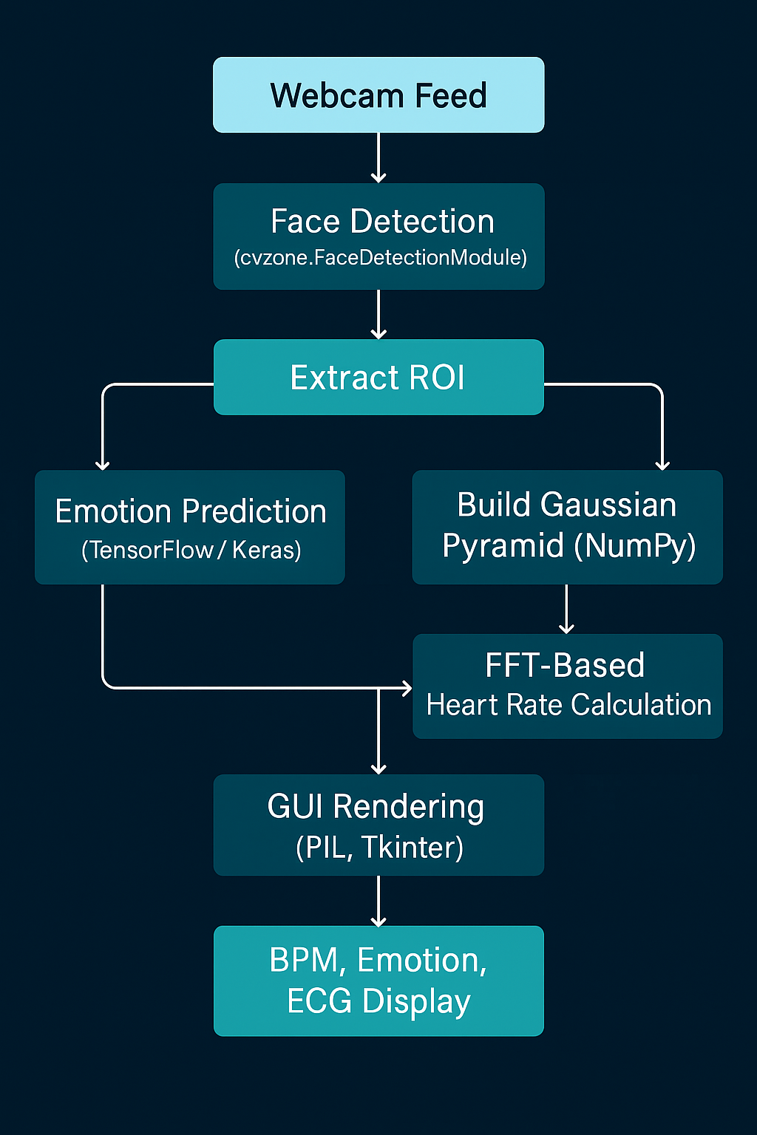
Conclusion

Slide 22
Challenges
Real-time Processing and Delay Handling
Capturing video, analyzing FFT signals, and predicting emotions needs to happen every few milliseconds.
Any lag in processing can cause a choppy user experience or inaccurate readings.
Careful buffer handling and Tkinter’s after() method are used to manage updates smoothly.
Signal Noise in FFT Outputs
Even slight body movement or background changes can introduce noise in the color variation signals.
Filtering out unwanted frequencies with a mask helps improve the accuracy of BPM detection.

Slide 23
Challenges
Lighting and Face Positioning Issues
Natural lighting can drastically affect ROI clarity.
Detection fails if the face is partially covered or not centered—impacting both BPM and emotion results.

Slide 24
Highlights
Dual Monitoring: Heart + Emotion
The system not only detects emotional state but also gives an estimated heart rate in real-time, combining physical and psychological monitoring.
Interactive and Easy-to-Use GUI
GUI built using Tkinter includes live webcam feed, ECG canvas, and clean labeling, making it intuitive and user-friendly.
Modular and Extendable System
Each component (face detection, BPM logic, emotion recognition, UI) is modularly coded.
Future additions like stress detection or data logging can be added without rewriting the core.

Slide 25
Future Scope & Applications
Future Scope
Improve accuracy using deep learning-based HR estimation (e.g., remote PPG models).
Integrate stress or fatigue detection using multi-modal input (face + voice + movement).
Add data logging and analytics dashboard for long-term health monitoring.
Deploy on edge devices or mobile platforms for wider accessibility.
Real-World Applications
Remote health monitoring for elderly or chronically ill patients.
Smart classrooms/workspaces to analyze engagement and emotional state.
Emotion-aware gaming or entertainment systems.
Mental health analysis tools in counseling and therapy.

Slide 26
Conclusion
Successfully integrated emotion recognition with non-contact heart rate monitoring using facial signals.
Achieved real-time performance with smooth visual updates via an interactive GUI.
Developed a modular and extendable system using Python, TensorFlow, OpenCV, and Tkinter.
Demonstrates potential for enhancing digital healthcare and smart user-aware systems.

Slide 27
Thank You

